Slide 1
PEACE Passenger Emotion Analysis for Commute Enhancement
'; DROP TABLE TEAM; --

Slide 2
The Idea
Improve ride experience & increase acceptance of autonomous vehicles in our society
We were interested in…
Facial detection & emotion analysis
Autonomous vehicles
PEACE enhances commute experience by leveraging passenger(s) emotions
Feedback network for the passenger & the driver
Application in Uber, Lyft, and other ridesharing services

Slide 3
What we achieved
Created an environment that will
Capture the facial expressions of passenger(s) periodically
Run emotion analysis on more than one person in a frame (9 different types of emotions)
Provide distraction-free voice alerts to the driver when passenger(s)
Are uncomfortable (sensing fear, anger, frustration or sadness)
Have been at ease for a while (positive reinforcement)

Slide 4
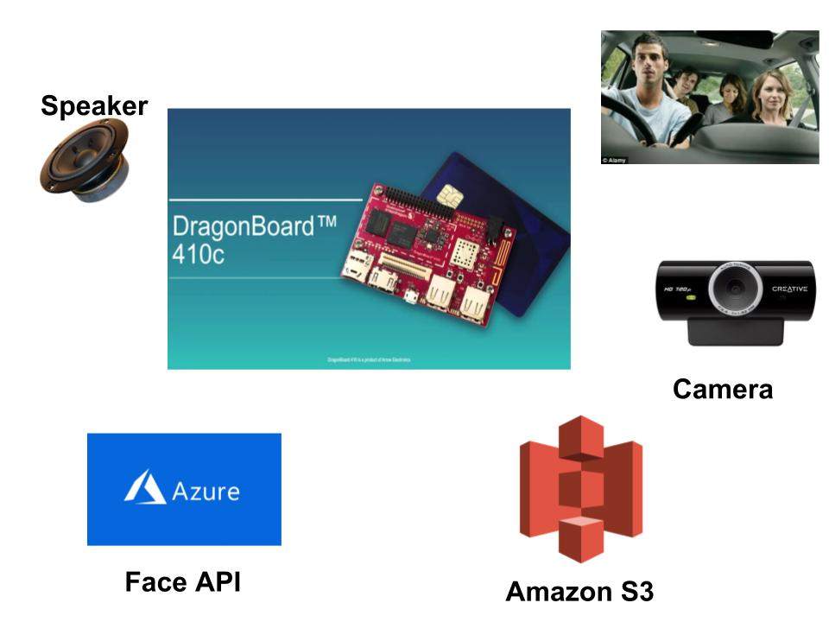

Slide 5
Next Steps
We created PEACE to integrate it in Qualcomm’s Drive Data Platform wherein we would use the on-device Machine Learning capabilities to train a model that would adopt to the passengers level of comfort with respect to road speeds, safe distance, preferred routes for travel and more. Future Plans
Eliminate false positives (Eg: if passenger is on the phone)
Analyze expressions in the dark
Changing songs
Create/utilize more APIs to detect other emotions or state of being
Analyze driver’s emotions/state-of-being to alert passenger (Uber, Lyft)

Slide 6
Questions?

